Slide 1
Addressing Disaster Risk Management in a context of growing humanitarian needs
December 12th, 2023
Alexandra Galperin,
Unit Head Disaster Risk Management, ADB

Slide 2
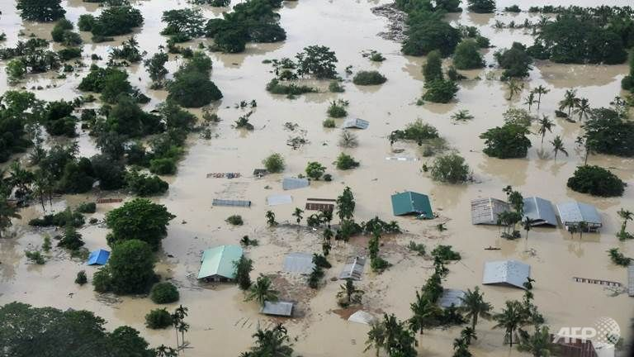
Over the period 2003-2022, disasters have affected 2.74 billion and caused an average economic impact of $178 million each day in Asia and the Pacific. Direct physical losses are increasing at the same pace as economic growth in ADB’s Developing Member Countries.
Source: AFP
Notes:
updated, 3oct23 – 2013-2022 (10 years)
----
Hence, as mentioned before, there is a high risk of rolling back development and concerning our DMC there is a huge amount of money missing to increase the welfare in Asia and the Pacific.
Putting this number into perspective to ADB’s target of 100bn climate financing by 2030, it would take only take a it more than 2 (2.3yrs) years to get to that amount!
Before we dive deeper into the economic impacts of disaster we would like to ask you a few questions that relate to disaster impact by ADB regions (regional departments).
Please type your answers in to the chat bar.

Slide 3
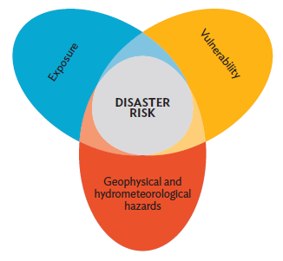
Primacy of Reducing Disaster Risks
Evidence Base: Understanding climate and disaster risk, and the underlying vulnerabilities
Managing risk through risk-informed development in and across sectors
Core objectives:
Reduce existing risks by investing in corrective measures (structural/non-structural) and building back better
Manage residual risk that cannot be effectively reduced including through disaster risk financing
Disaster and Climate Risk

Slide 4
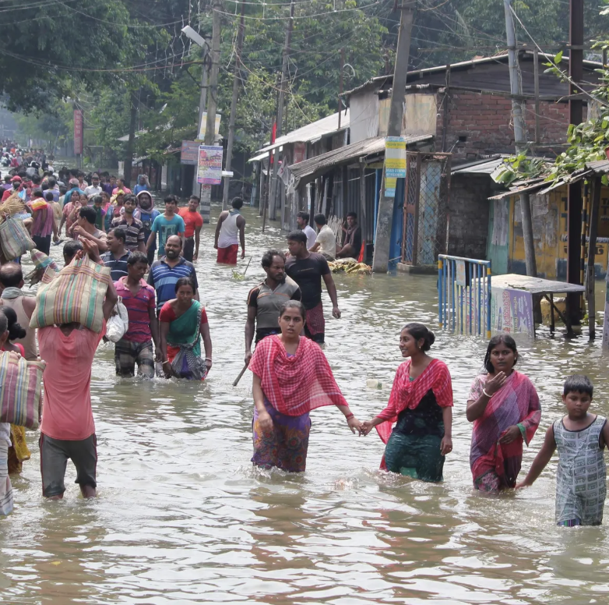
Disaster Risk Financing Arrangements for Residual Risks
Incentivize DRR through ex ante and ex post tools
Enabling environment:
Risk Analytics, Pre-feasibility studies
Public financial management in emergencies
DRF solutions for risk retention/ transfer:
Contingent Disaster Financing to 12 countries
City Disaster Insurance Solutions (Vietnam; Philippines)
Various insurance pilots benefiting the poor and near-poor

Slide 5
How ADB reaches those most in need
Macro-level
Country Classification: 29 countries have access to grants; 10 are “grant” only countries
Meso-level: Aggregated socio-economic, poverty and gender analyses and other relevant indicators (hazard exposure and social vulnerability indices)
HH-level: Disaggregated socio-economic, income and consumption indicators, gender, disability status etc. as relevant

Slide 6
Examples of targeting the poor:
Pacific: Contingent Disaster Financing Programs for the Pacific Islands (10)
Bangladesh: Reaching the urban poor through Coastal Towns Climate Resilience Project addressing resilient and inclusive urban infrastructure, resilient livelihoods and risk governance including gender and climate awareness.
India: $ 1.15 billion to social safety net program (cash payments and food transfers) for migrants and other vulnerable groups in India during Covid-19. Technical support to identification of beneficiaries and social registry.

